Slide 1
Recruitment challenge 2020
Nima Ghoroubi

Slide 2
Problem
Classify the images as containing cells who have or have not responded to the drug treatment
Idea? Well, patterns.
Classification, is it binary? Well not really, it is not yes it is effected and no it is not, there seems to be a transition also.

Slide 3
Approach
Simplification always makes stuff easier to grasp.
Two channels, but are they both necessary? Expert opinion might say yes, but I have no reason as to why (at the moment of doing this work)
Channel one stains are the ones that change, so I will figure a pattern there
You cannot do pattern recognition with a model that is trained on 6 images
But that is not the end

Slide 4
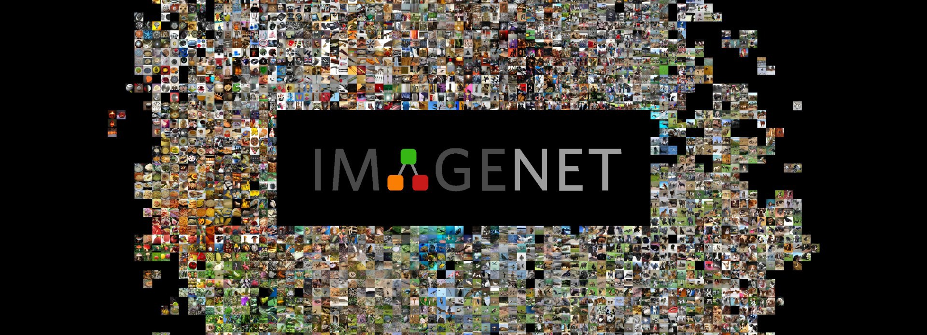
Work hard, or smart?

Slide 5
Method
Steps:
Import the images
Pre-process them to an understandable/fit candidate for VGG16 to predict which category it belongs to
Predict which category the image is in (feature prediction)
Use these features within a K-means clustering

Slide 6
Validation
A simple series of small circles, large circles, one star, long lines and short lines could be classified with 100% accuracy
Same network was used for the 6 images with 4 possible clustering groups
Lets assume these are a logical phase based on drug dosage:
Not reacting
Minor reaction
Noticeable reaction
Fully reacting

Slide 7
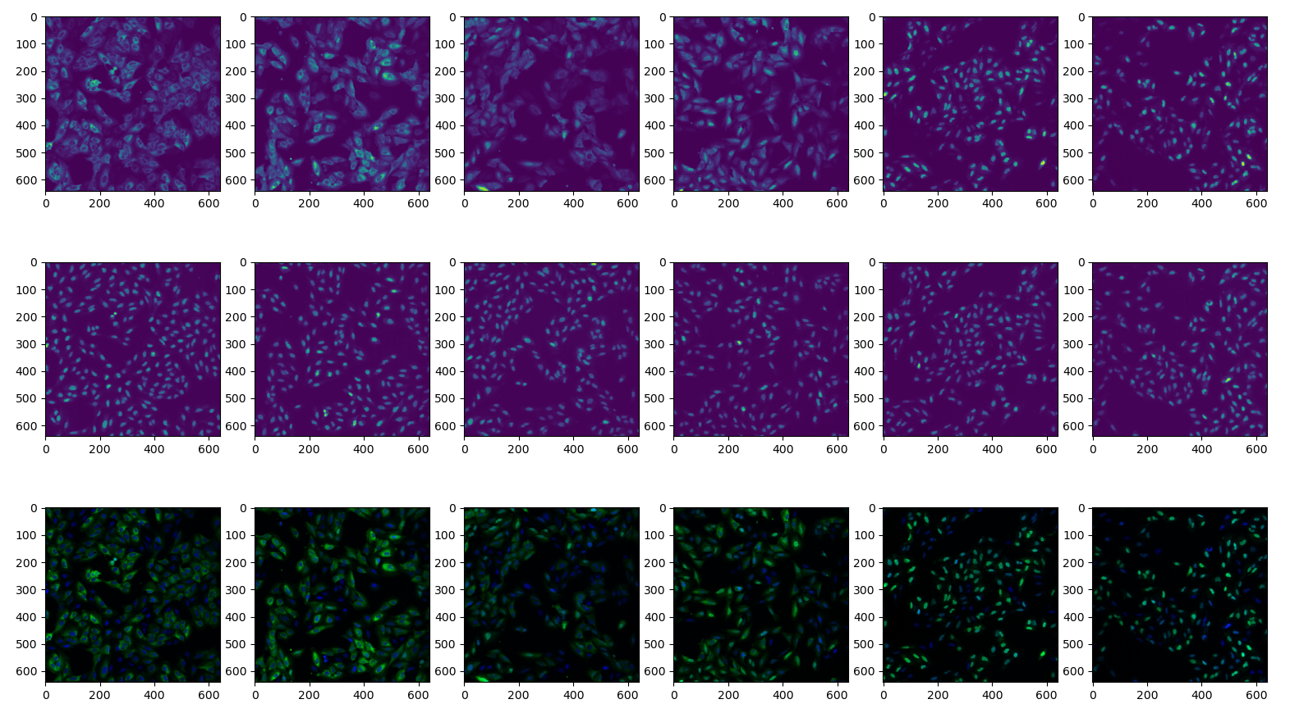
[2 1 3 3 0 0]

Slide 8
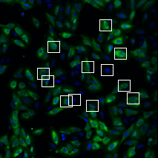
The “Finally” part
The longshot “ideal” solution
Go with what facial recognition does but with cells
Extract a number of samples manually and use different angles, scales to generalize
Train a network to give estimates of a cell being in either of “m” cases (unaffected, in process, fully affected (?))
Use this network to extract the rest of cells
Retrain the network to be used for feature extraction
Predict new cells, by either clustering or directly

Slide 9
Drawbacks
Could fail, an ideal idea is not necessarily implemented the same exact way
Could potentially be very time consuming and processor hungry
Could potentially overfit to a certain dataset and be very unsuitable for other applications

